Slide 1
STUDENT ADMINISTRATION SYSTEM
GROUP 4

Slide 2
Team members
Anav Chand – S11221203
Lanuongo Guttenbeil – S11215322
Rohan Nandan – S11234883
Vishant Kumar – S11230430
Zhixian Chen – S11230686

Slide 3
Executive summary
Problem Statement
The current system is inefficient with a fragmented, decentralized database, requiring manual entry of student data, academic records and scheduling
Proposed Solution
A new robust and multi-functional student management system which streamlines and automates school administrative services.

Slide 4
Scope of implementation
Authentication & authorization module
User management module
Subject management module
Class management module
Assessment management module
Report generation module

Slide 5
Authentication & authorization module
Json Web Token-based authentication system
Role-Based Access Control (RBAC) with 3 user types:
Admin: Full system access
Teacher: Dashboard and Classes access
Student: Dashboard and enrolled Classes access
Login functionality (no signup - admin creates users)
Automatic redirection for unauthorized access
Password reset functionality

Slide 6
User management module
Staff Management (Admin Only)
View all staff members
Add new staff (teachers)
Edit staff details
Delete staff members
Student Management (Admin Only)
View all students
Add new students
Edit student details
Delete students

Slide 7
Subject management module
Create new subjects
Edit subject details
Delete subjects
View all subjects
Assign subjects to classes

Slide 8
Class management module
Class Operations (Admin)
Create new classes
Edit class details
Delete classes
View all classes with teacher and student counts
Assign teachers to classes
Class Enrollment (Admin)
Enroll students in classes
Remove students from classes
View enrollment status

Slide 9
Assessment management module
Assessment Operations (Admin & Teacher)
Create assessments for classes
Edit assessment details
Delete assessments
View all assessments for a class
Marks Management (Admin & Teacher)
Enter marks for students
Edit existing marks
View marks for all students in an assessment
Track completion status (marked/unmarked)
Individual student mark sheets

Slide 10
Report generation management module
Class Marksheet (PDF):
All students in a class
All assessments with marks
Subject-wise breakdown
Weighted totals
Final grades
Subject Report (PDF):
Select specific subjects
All students' performance in selected subjects
Assessment-wise breakdown
Subject averages
Student Report (PDF):
Select specific students
Individual performance across all subjects
All assessment marks
Overall performance summary

Slide 11




Technology stack
Next.js (TypeScript)
Spring Boot (Java)
PostgreSQL
Amazon Web Services

Slide 12
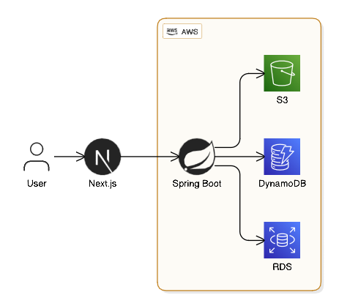
Architecture

Slide 13
Architecture: MVC
View
REST API (JSON)
Controller
JDBC/JPA
Model
PRESENTATION Layer
Next.js + React + TypeScript
Port: 3000
APPLICATION Layer
Spring Boot + Spring Security
Port: 8080
DATA Layer
PostgreSQL Database
Port: 5432

Slide 14
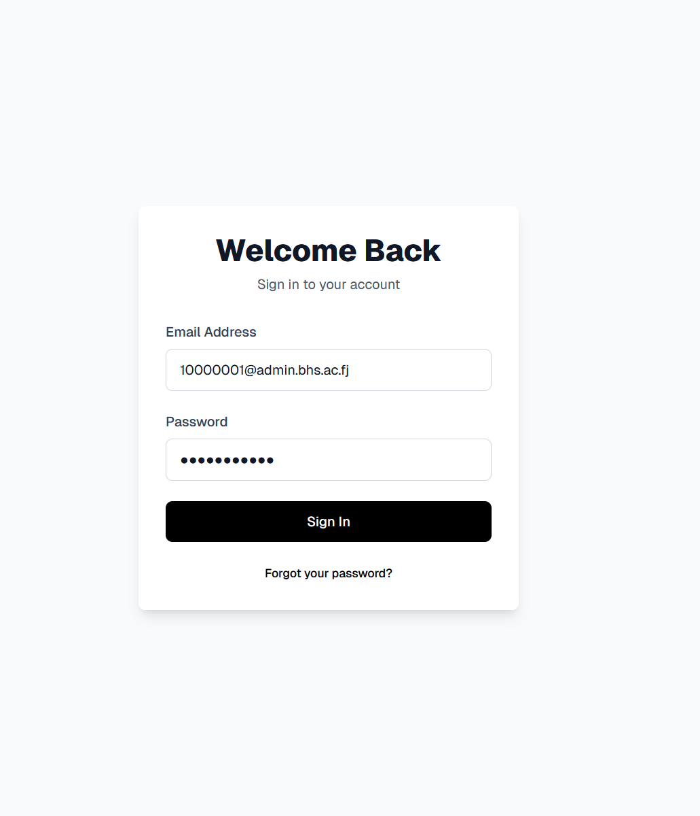
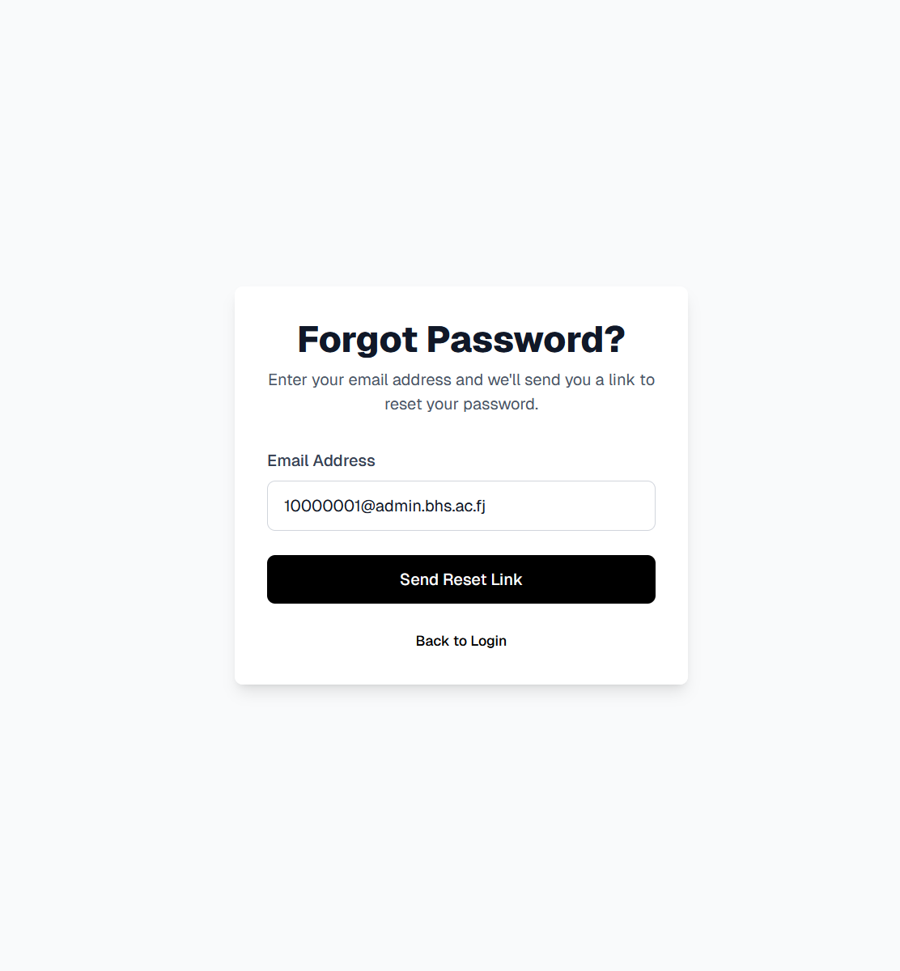
User interfaces
1.1 Authentication

Slide 15
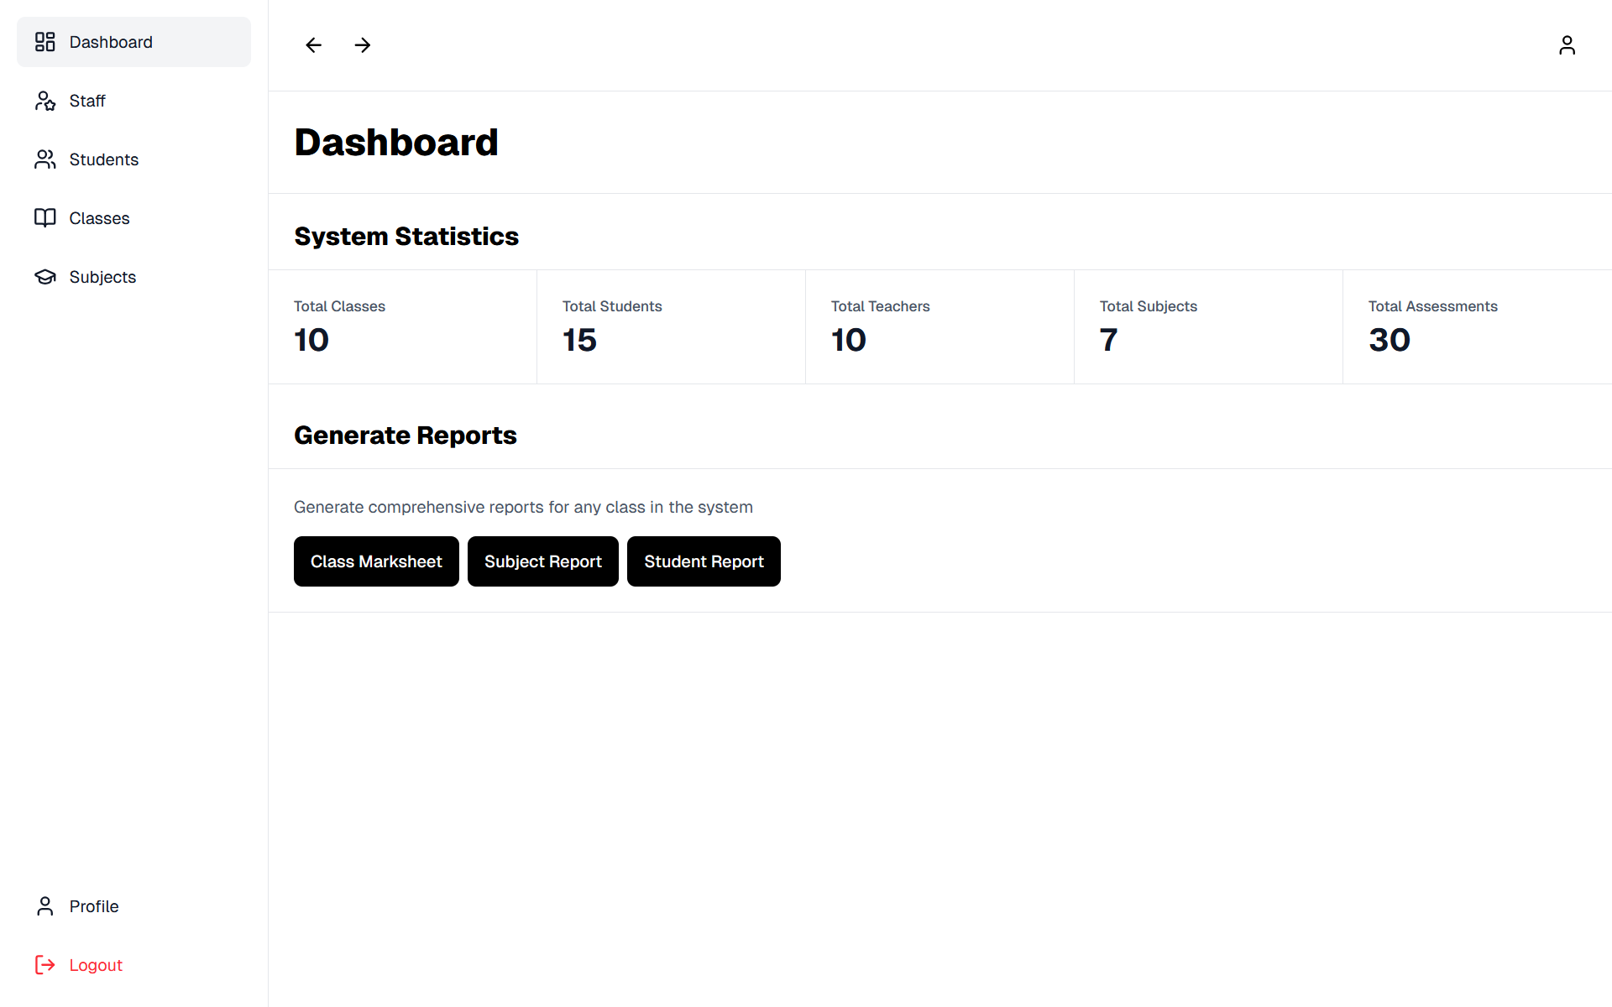
User interfaces
1.2 Dashboard

Slide 16
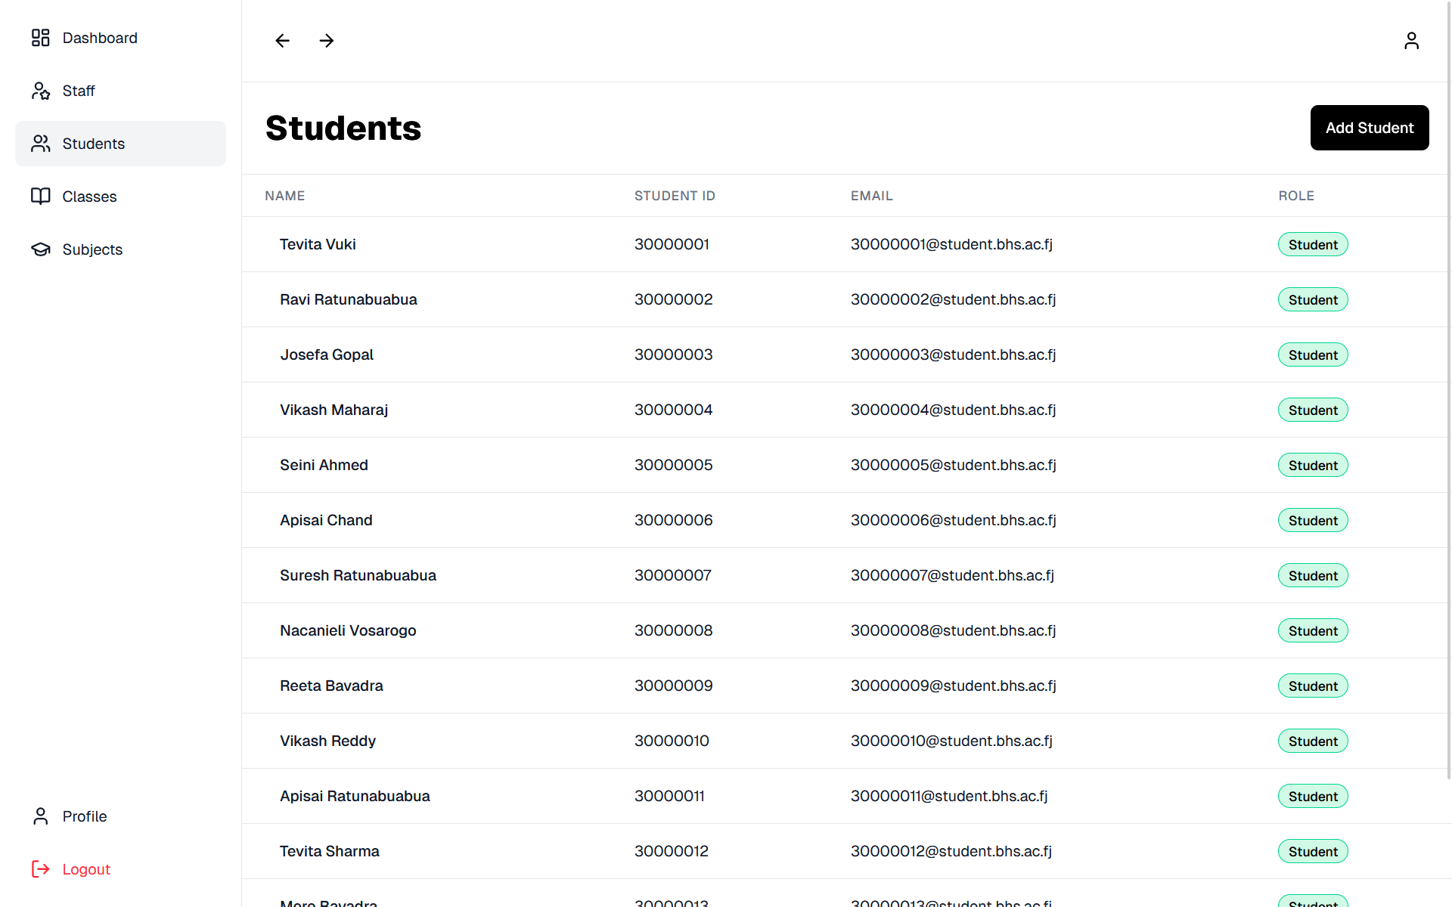
User interfaces
1.3 Student Management

Slide 17
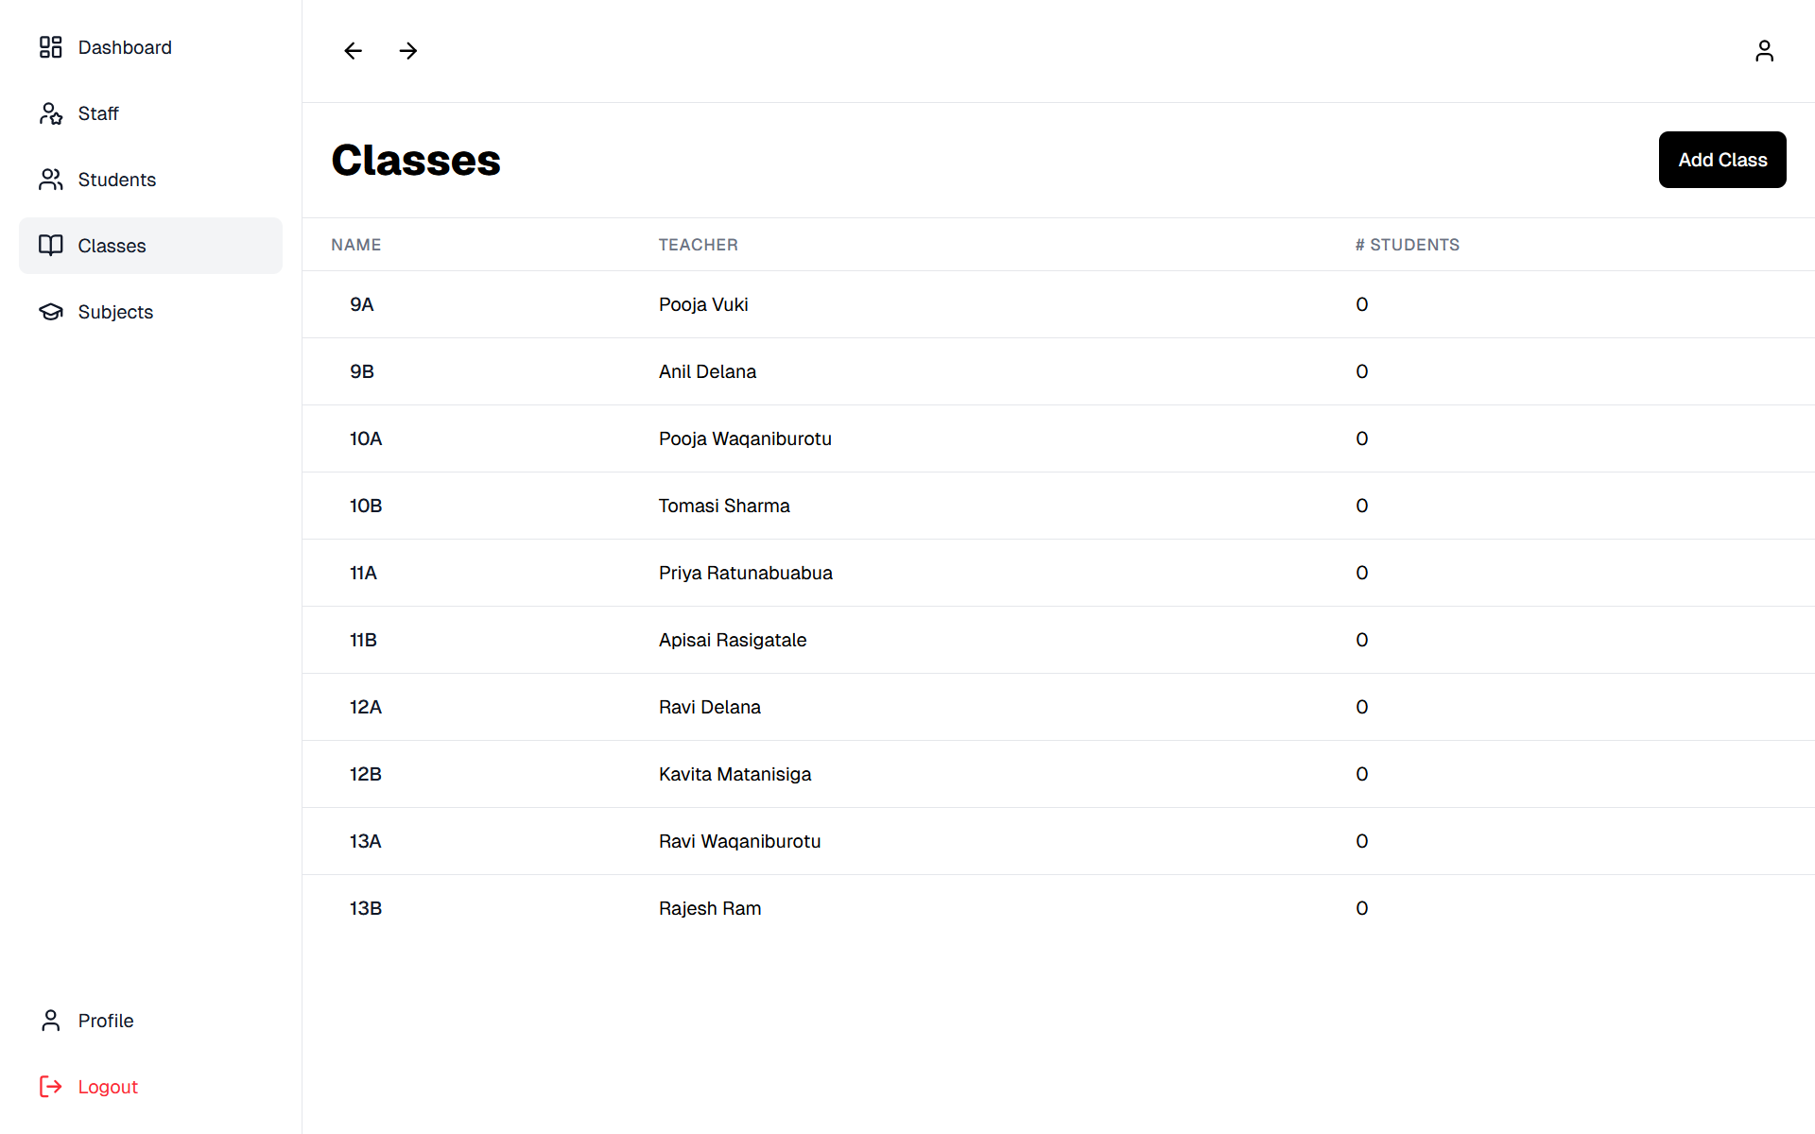
User interfaces
1.4 Class Management

Slide 18
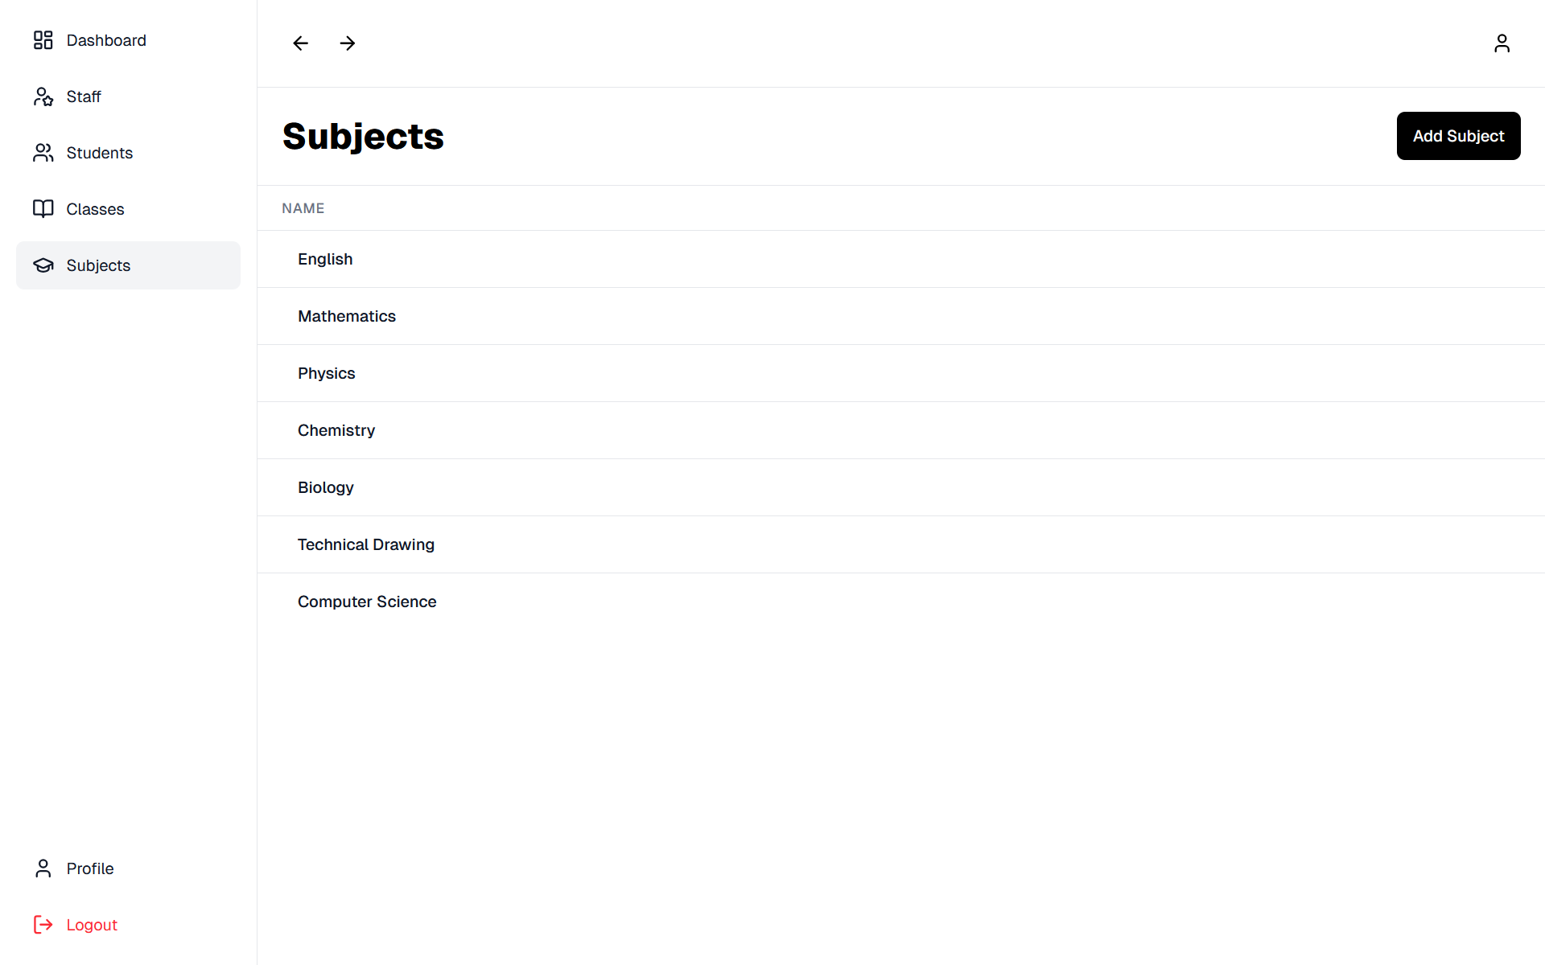
User interfaces
1.5 Subject Management

Slide 19
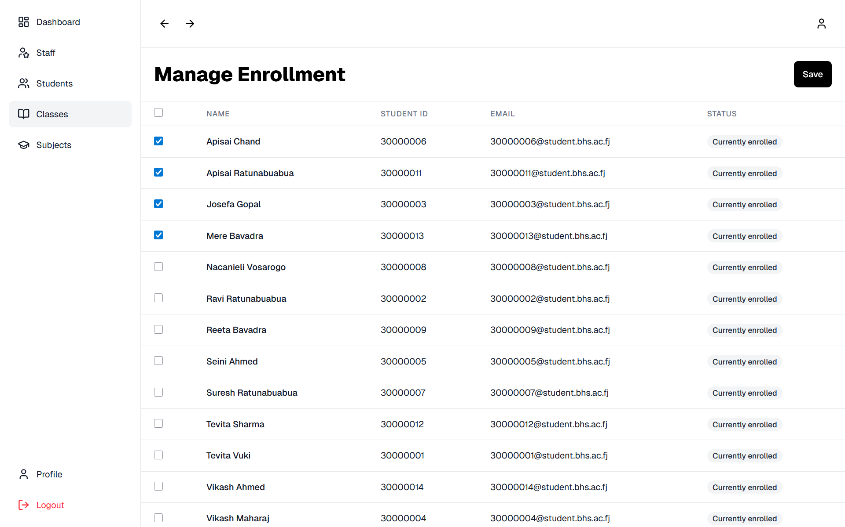
User interfaces
1.6 Class Enrollments

Slide 20
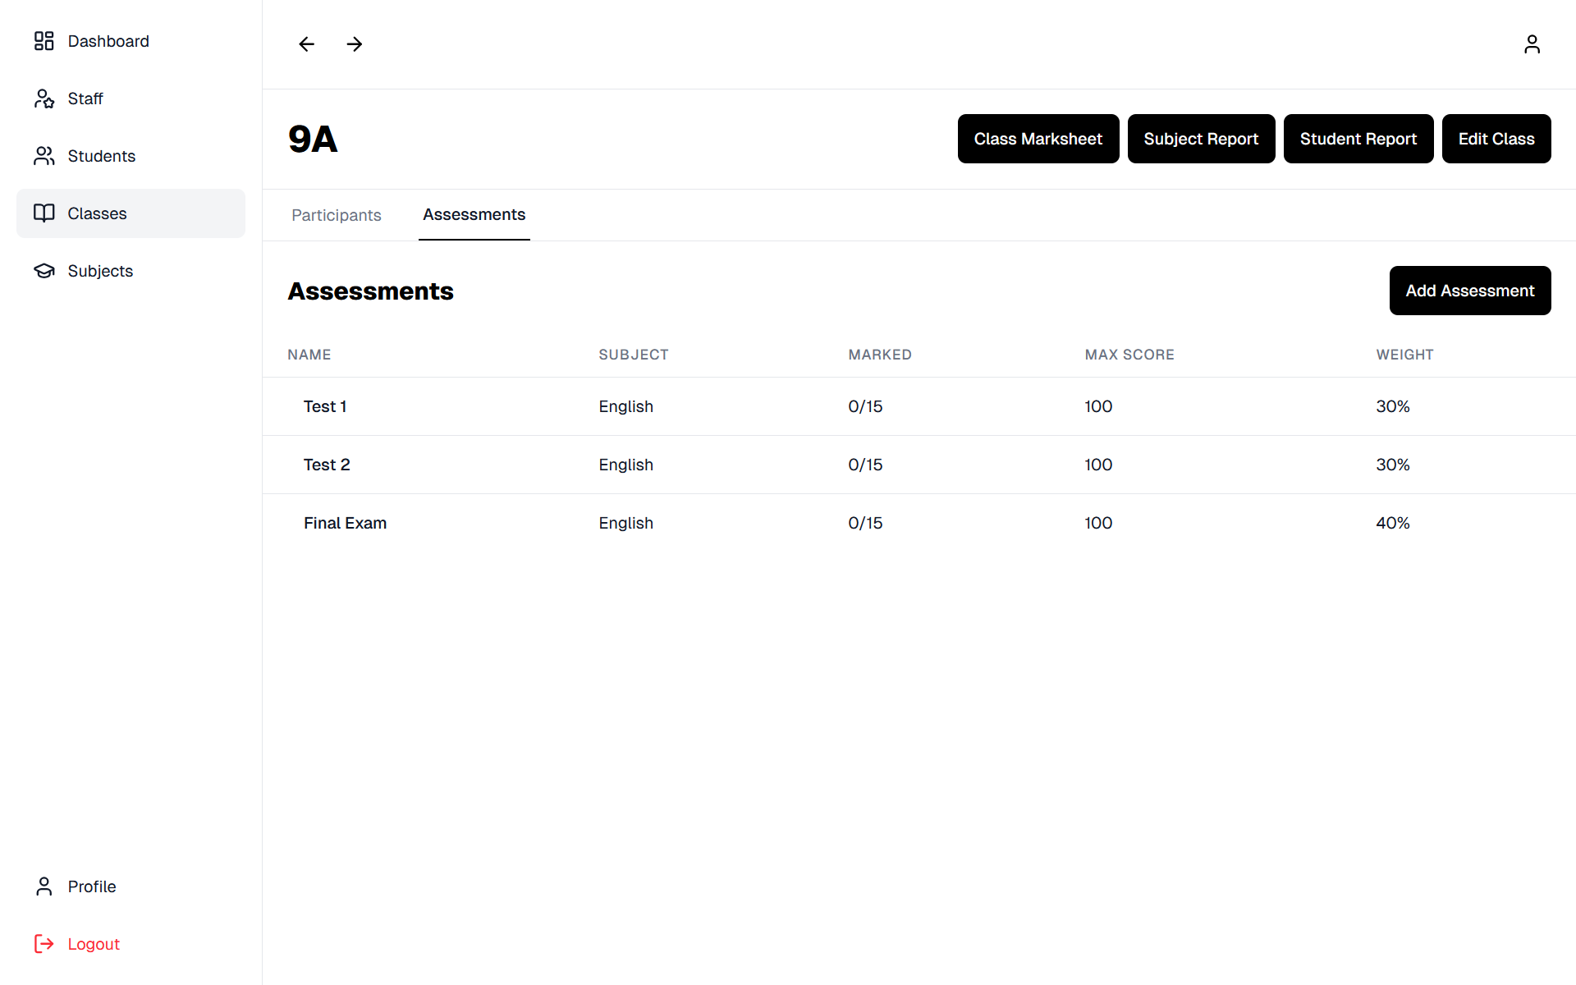
User interfaces
1.7 Assessment Management

Slide 21
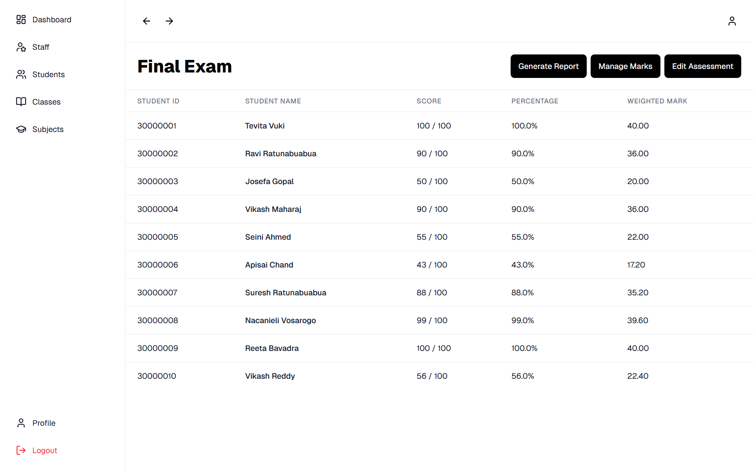
User interfaces
1.8 Assessment Mark Management

Slide 22
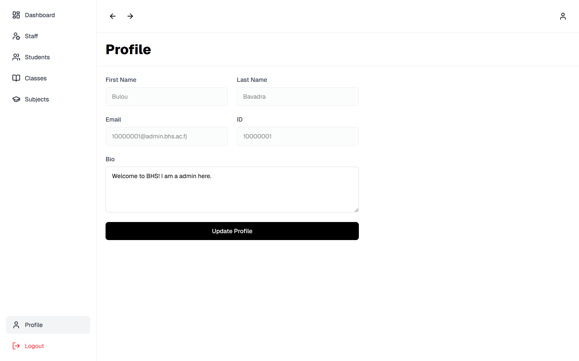
User interfaces
1.9 User Profile

Slide 23
Testing and Integration
Unit Testing
UserRepositoryTest.java - used to test CRUD operations and validating database constraints.
Frameworks: JUnit 5, Spring Boot Test & AssertJ
Blackbox Testing
Operations were tested with input to ensure exception handling was implemented corrected.
Top-Down Integration
Logical artifacts such as page routing and user interface components were testing using top-down integration by verifying controller endpoints to ensure return of correct data structures before connecting to actual database operations.

Slide 24
Lessons learnt
Program Modularization
Separation of reusable components into smaller, independent parts made development smoother. Maintained consistent user-interface design.
Continuous Testing and Integration
Testing modules as they are integrated into the system ensured that conflicts did not arise later in development.
Version Control
Backups of codebase ensured quick recovery to older versions incase of code failures and loss of progress.

Slide 25
Contribution sheet
Team Member | Percentage Contribution | Responsibilities
Anav Chand | 20% | Authentication and Staff Management
Vishant Kumar | 20% | Student Management and User Profile Management
Rohan Nandan | 20% | Class Management and Enrolment Management
Zhixian Chen | 20% | Assessment and Marks Module
Lanuongo Guttenbeil | 20% | Subject Management and Report Generation

